Slide 1
Small Schools Network Meeting
John Rowe, School Improvement Adviser
Sheri Wright, Senior Educational Psychologist

Slide 2
Aims
To provide support to promote the wellbeing of headteachers in small schools.
To consider particular challenges facing small schools with respect to the quality of education and the leadership and management and to share strategies and solutions for school improvement.
To provide a forum for shared discussion and to enable small school headteachers to grow their professional networks

Slide 3
Introductions – Why are we here?

Slide 4
Headteacher wellbeing

Slide 5
World Health Organisation
Health is a state of complete physical, mental and social well-being and not merely the absence of disease or infirmity. An important implication of this definition is that mental health is more than just the absence of mental disorders or disabilities.
Mental health is a state of well-being in which an individual realizes his or her own abilities, can cope with the normal stresses of life, can work productively and is able to make a contribution to his or her community.
Mental health is fundamental to our collective and individual ability as humans to think, emote, interact with each other, earn a living and enjoy life. On this basis, the promotion, protection and restoration of mental health can be regarded as a vital concern of individuals, communities and societies throughout the world.

Slide 6
Why it matters? (to everyone)
Professional wellbeing underpins effective school improvement
Schools have faced (and continue to face) unprecedented pressures (social, Covid, financial, staffing shortages)
Need to balance professional wellbeing and expectations of professional role
It’s not just about teachers.

Slide 7
“Should an emergency situation occur, you need to put your own oxygen mask on first, before attempting to help those around you.”

Slide 8
Introducing Sheri Wright
Specialist Senior Educational Psychologist for Emotional Health and Wellbeing

Slide 9
NHS Five Steps to Wellbeing

Slide 10
Find ways to collaborate (with other heads) – avoid the bunker
Delegate
Consider seeking supervision and support
Refresh whole school values (and live it)
SDG
Talk on the phone rather than email
Talk to someone
Eat lunch with others
Organise (and attend) a social event
Ask for help
???

Slide 11
Moving or standing more at work. Building habits for active movements into work day
Join in with the daily mile
Prioritise exercise when not in school
Make time to go for a walk at lunchtime
Break up long periods of sitting
Have walking meetings
???

Slide 12
To say ‘no’ – stick to your own school agenda
To turn off ‘push notifications’ on emails.
From difficulties
To plan ahead. Consider what is important and urgent, what is important (but not urgent) and what can wait
To accept that you will never complete all tasks – learn to delegate and prioritise
To make space and time to focus on specific tasks (including off site)
Don’t neglect your own training and development needs
Make time for a new hobby
Learn a new function of well-used software (e.g. electronic calendars)
Set a goal and work towards achieving it
???

Slide 13
Arrange training for governors
Complimenting someone
Helping a colleague
Sharing ideas or feedback
???

Slide 14
Do one thing at a time
Of what you are achieving. Don’t be your own harshest critic.
Sit someone quiet
Keep beautiful object near your desk
Of the signs of stress and do something about it
???

Slide 15
How governors can help
Governors should recognise their responsibilities
Make professional wellbeing a key focus
Agree a ‘communication strategy’ on use of phone calls and email
Keep focused on what matters (not car parking)
Appoint a wellbeing governor
Take on specific tasks and projects by negotiation

Slide 16
Governors awareness about headteacher’s wellbeing
Governors have become much more conscious of the importance of headteacher wellbeing
GovernorHub survey of 4000 governors (2021)
81% say their boards track school and trust wellbeing and workload
58% say the pandemic prompted board to track leaders workload and wellbeing more closely
57% have concerns about the wellbeing and workload of school leaders.

Slide 17
Sources of support
Schools & educational establishments please contact Sheri Wright Specialist Senior Educational Psychologist (01743) 258414 eps@shropshire.gov.uk
Other services contact: NOSS (Network of Staff Supporters) - (01978) 780479 (24 hour answer phone)
Advice/information on the Counselling Service can be provided by contacting Occupational Health Service on (01743) 252833 or occupationalhealth@shrophire.gov.uk

Slide 18
Sources of support
Offer a FREE daily wellbeing telephone support service for headteachers. As experienced ex-heads ourselves, we volunteer our services for free and receive no funding or payments.
0800 862 0110
hello@headrestuk.co.uk
Available to talk Monday - Thursday, 7.00pm - 8.00pm or at a pre-arranged time to suit.

Slide 19
Sources of support
This service is for headteachers, deputy headteachers, assistant headteachers, MAT CEOs and MAT Deputy CEOs based in state funded primary or secondary schools.
You must be able to attend six sessions of either online professional supervision
This service is funded by the Department for Education

Slide 20
Break time

Slide 21
Curriculum design in a small school context

Slide 22
What is a coherently planned and well sequenced curriculum? – the Box Set
Almond N (2020) Curriculum coherence: How best to do it? In: Sealy C and Bennett T (eds) The Research Ed Guide to The Curriculum. Woodbridge: John Catt, pp. 59–69
Overarching plot – carefully sequenced
Individual episodes contribute to narrative of the series to build on prior learning
Individual series subplots contributes to the end points
Each episode has it’s own purpose and deepens understanding
Revisits previous content (‘previously….’)
Increasingly complex use of vocabulary
Engaging, entertaining but makes the viewer think hard!

Slide 23
Need to know the characters but no overarching plot or sub plot
Stand alone episodes don’t build deep understanding
Can access in any order as sequence is unimportant
Enables shallow knowledge to be gathered
Entertaining but doesn’t require a lot of hard work on the part of the viewer!

Slide 24
A well designed curriculum
End points known. Core knowledge identified to access subsequent learning
Move from shallow to deeper knowledge
“Why this, why now” - Considers how concepts develop and builds on prior learning
Provides opportunities for high challenge/low threat opportunities for retrieval which is generative

Slide 25
PAN of 23 – mixed aged (and mixed key stage classes)
Operate a four year rolling programme of themes to ensure sufficient coverage of the National Curriculum for history and geography.
Programme operates over a key stage to ensure consistency between year groups in different classes.

Slide 26
For other subjects, a two-year programme operates as a pupil may spend two consecutive years in one class. The content of these subjects carefully structured to complement the theme, ensure coverage and plan for progression.

Slide 27
Sequence ensures the curriculum - :
1) Meets the needs of learners
2) Builds on prior learning
3) Provides opportunities for children to practise their skills through artistic repetition.
4) Supports, where possible, the broader theme.
5) Prepares children for the next phase of their learning and further study
6) Pays attention to the values that run through our topics

Slide 28
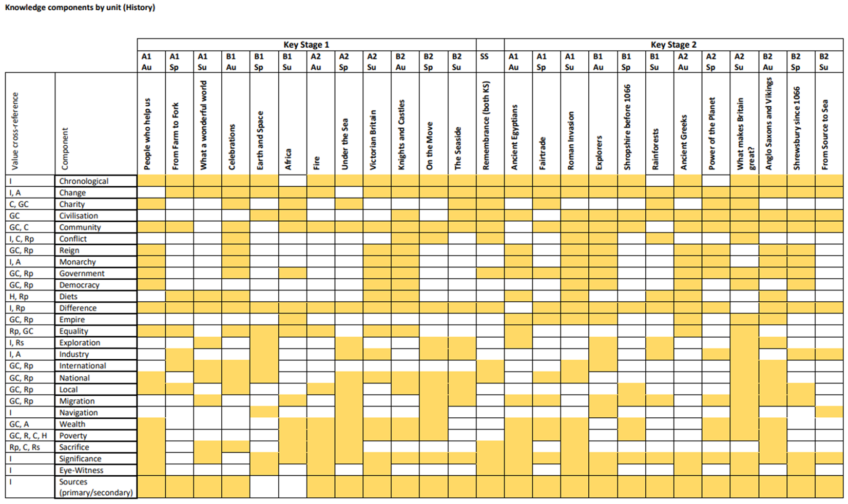

Slide 29
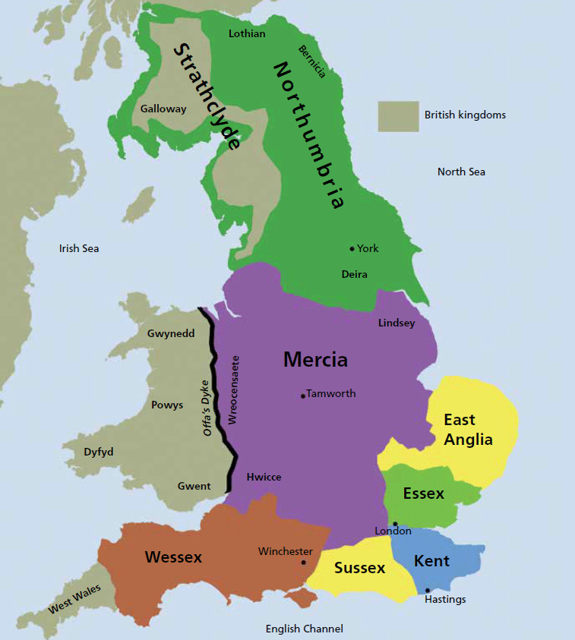
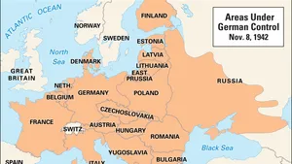

Slide 30
What did Ofsted say….
“Leaders have been working on new curriculum plans over the past four years.”
“They are ambitious for all pupils and have thought carefully about how to make the curriculum meet the needs of mixed-age classes.”
“Leaders and teachers know how to help pupils remember knowledge and skills. Pupils have many opportunities to practise and revisit learning.”

Slide 31
A curriculum model for small schools

Slide 32
A different analogy for high quality small school curricula – prototype theory
A collection of blockbuster superhero films, each of which stands alone as a complete story and which can be watched in any order.
Each movie has an epic story of its own,
Films surrounding one element or character in depth. Each time you watch a new film, new connections between them become apparent – even more so while sat next to an aficionado who has spent time thinking deeply about how the movies link ….
Small school curriculum supports pupils’ developing understanding of memory through repetition of concepts and carefully chosen content to support this.
Teachers are the aficionado – supported by deep knowledge of the pupils

Slide 33
“Why this, why now?”
Intent is so much more than ‘vision and values’.
How do concepts repeat to develop and deepen knowledge and understanding?
Story matters – our brains privilege stories and this can provide the ‘hinterland’ of knowledge to broaden schema.
Choices are key

Slide 34
If William Morris did curriculum design…

Slide 35
If William Morris did curriculum design…
Have nothing in your curriculum you do not know to be useful, or believe to be beautiful.

Slide 36
Time to share…
How do you develop a curriculum for pupils to ‘know more and remember more’ in a small school context?
What barriers have you encountered and how are they being overcome?

Slide 37
Resources to support school self evaluation of the curriculum

Slide 38
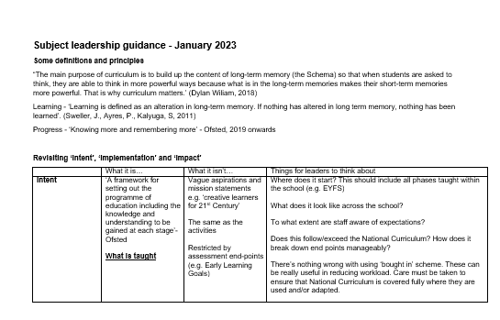
Self Evaluation Tool

Slide 39
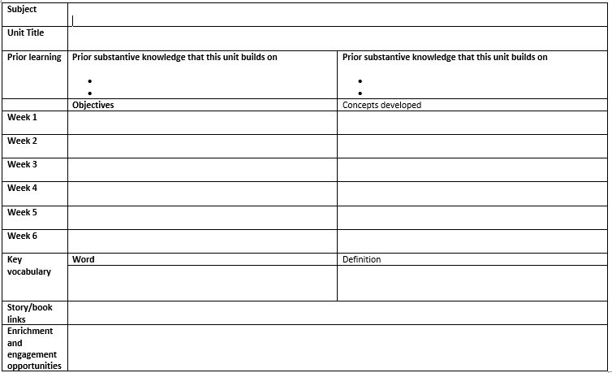
Unit Plans

Slide 40
EEF 7 step model
https://educationendowmentfoundation.org.uk/news/eef-blog-modelling-independence-the-seven-step-model-planning-tool
Strategies to adapt teaching and cultivating independence
Move from dependence to independence in learning
Improve pupil performance and confidence

Slide 41
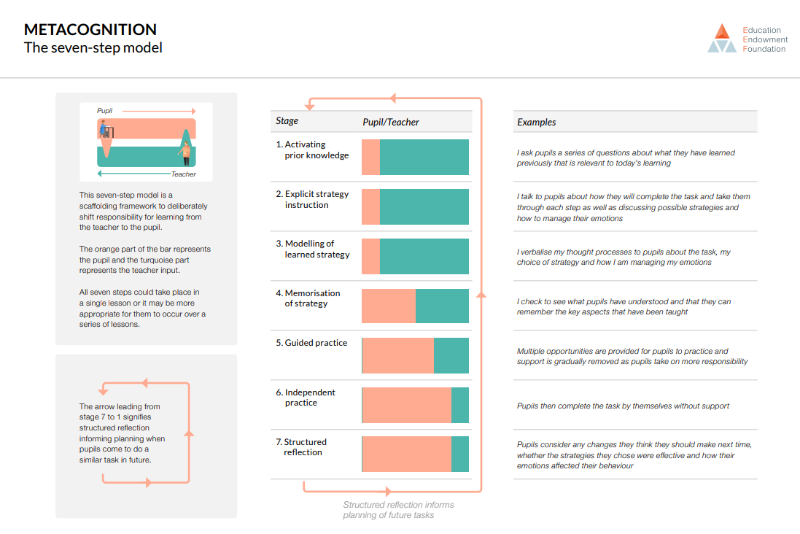
EEF 7 step model

Slide 42
Thoughts and questions?

Slide 43
What next?
How would you like to see the small school network develop?
What areas would you like to explore?

Slide 44
Please complete your evaluations

